Slide 1
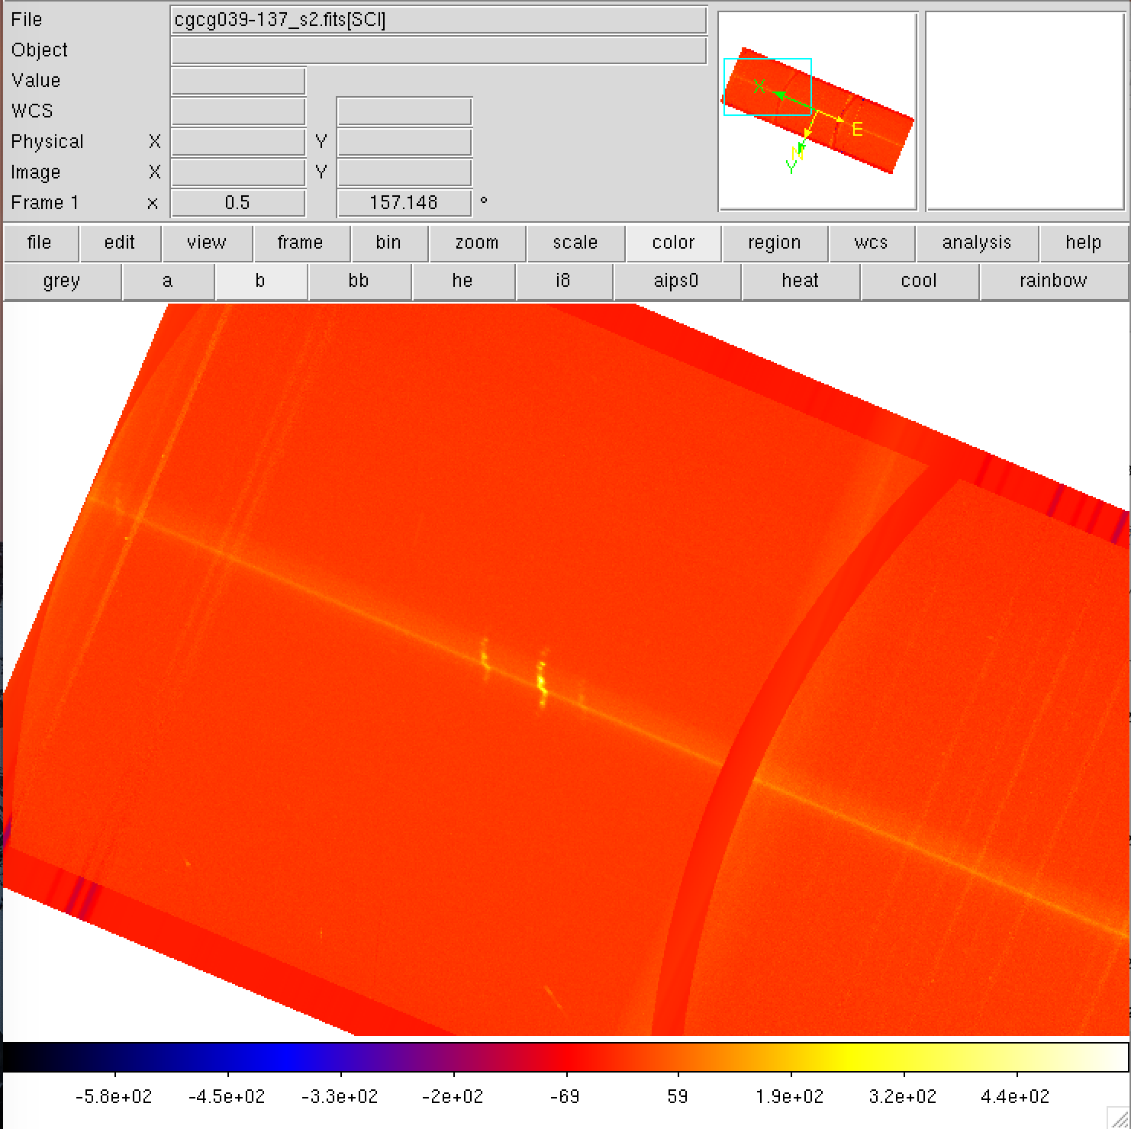
Red side
Blue side
Increasing wavelength
Notes:
Corrected (11/2017)

Slide 2
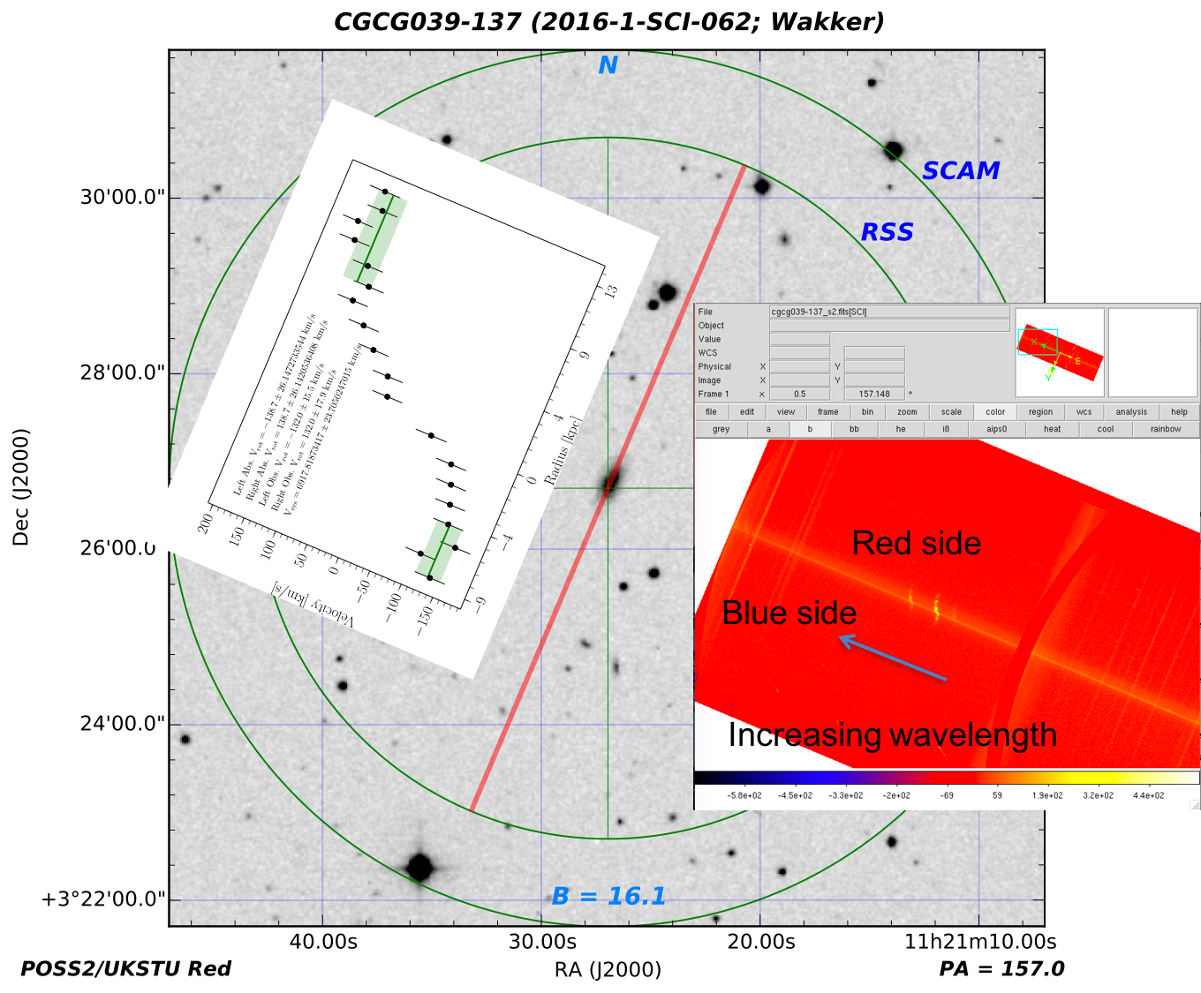
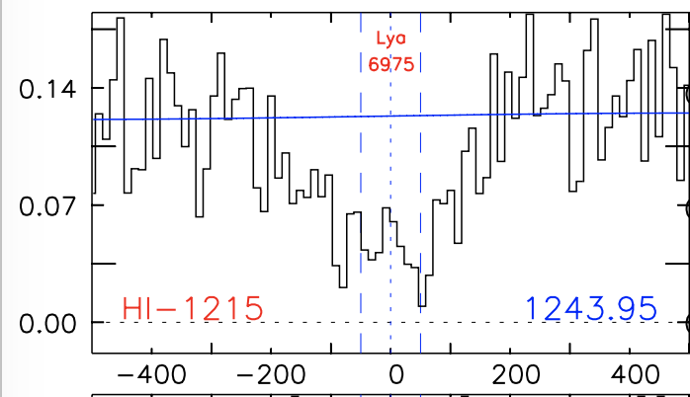
+132 km/s
-132 km/s
Nothing
dv = 73km/s
Notes:
Corrected (12/062017)

Slide 3
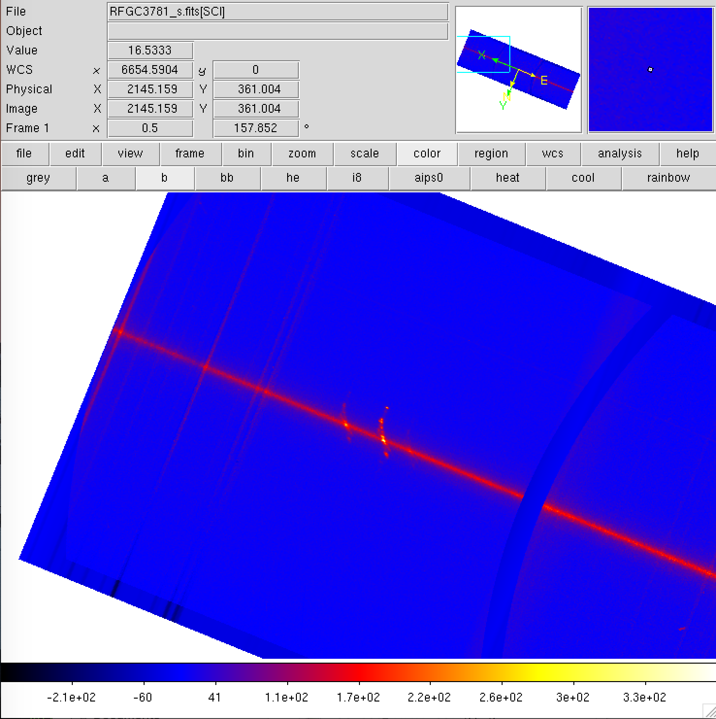
Red side
Blue side
Increasing wavelength
Notes:
Correct (11/20/17)

Slide 4
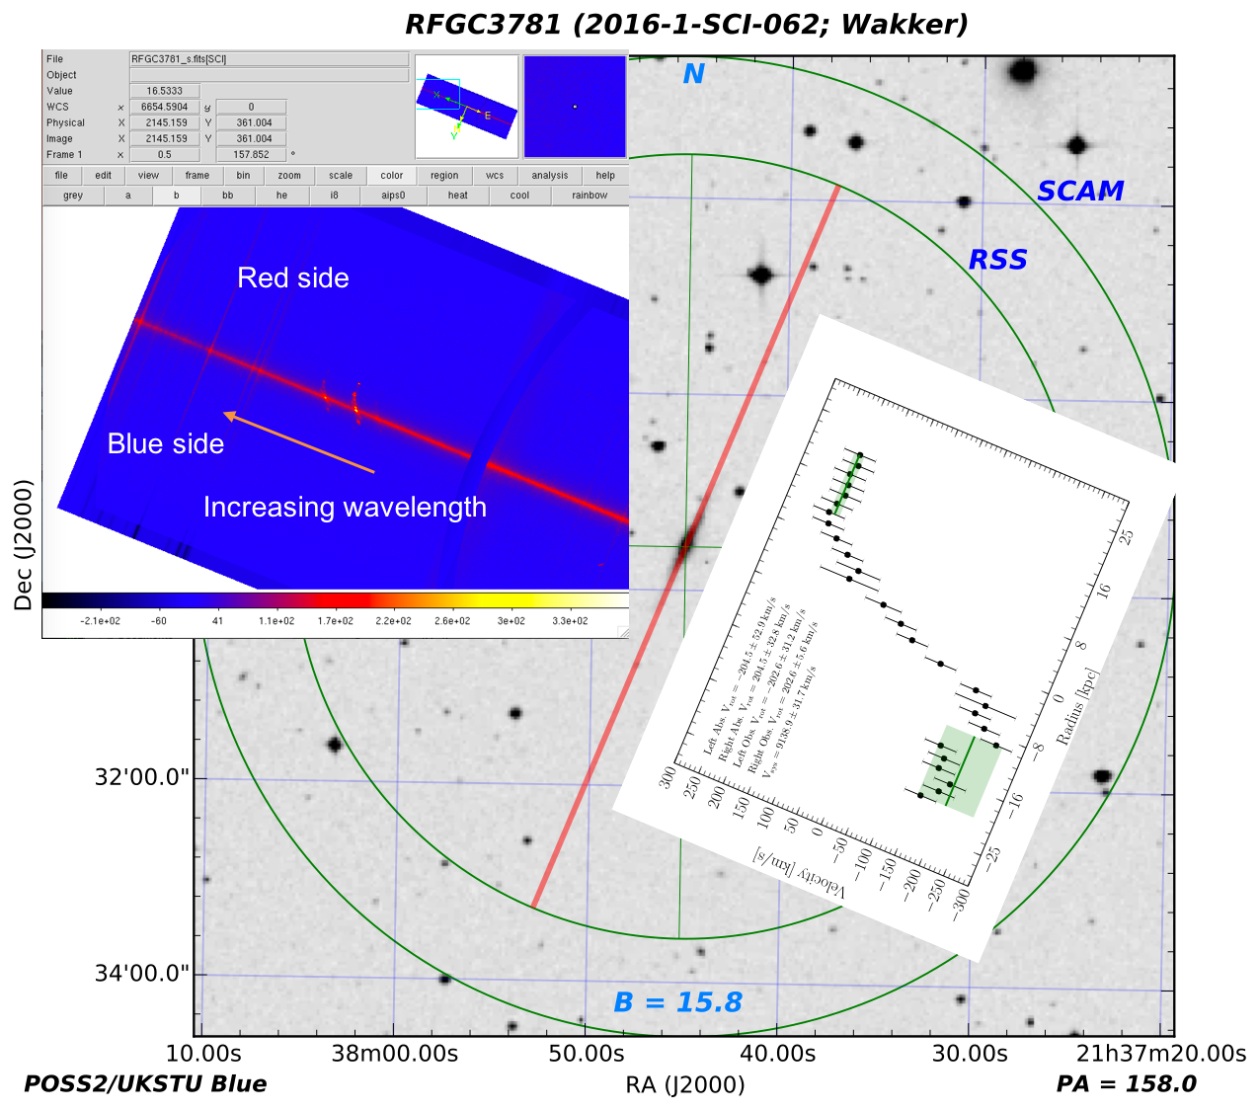
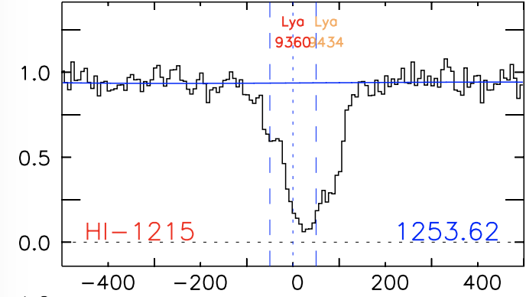
+203km/s
dv=198
dv=272
-203km/s
Notes:
Correct (12/23/17)

Slide 5
impact
galaxy
sightline
Notes:
Corrected (11/2017)

Slide 6
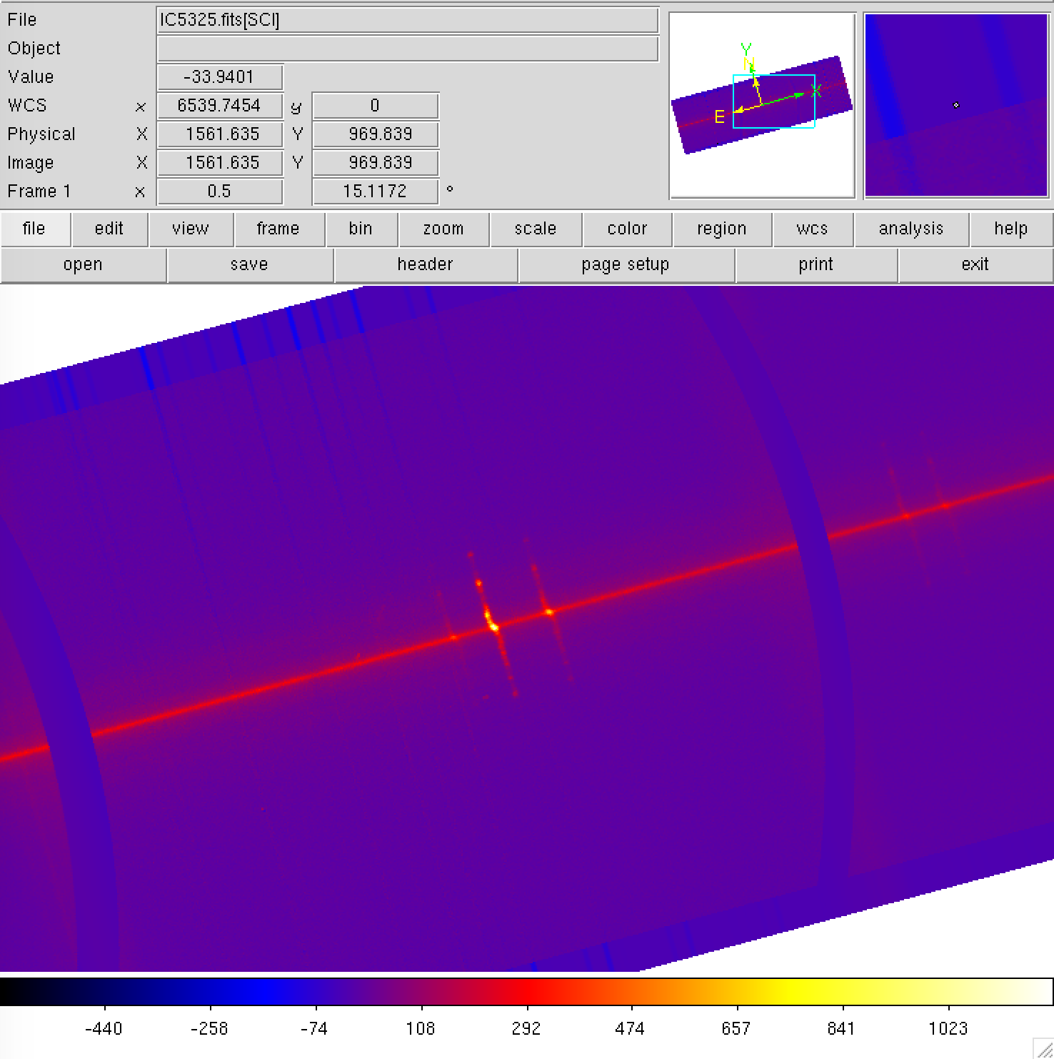
15 deg rotated
Blue side
Red side
Increasing wavelength
Notes:
Correct (11/20/17)

Slide 7
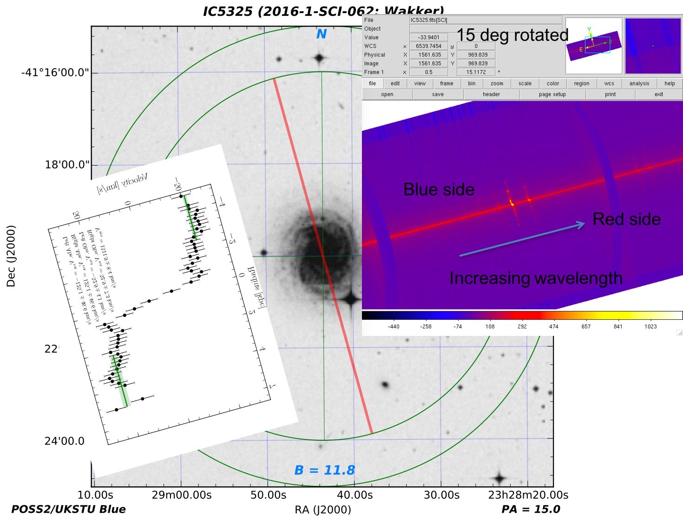
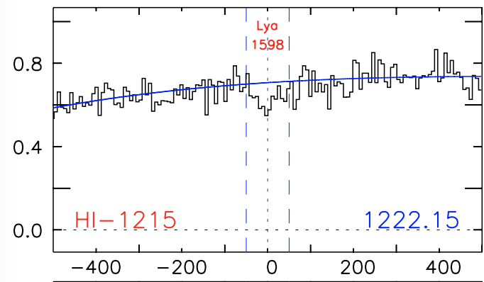
dv = +95 km/s
-53 km/s
+53 km/s
Notes:
Correct (12/06/17)

Slide 8
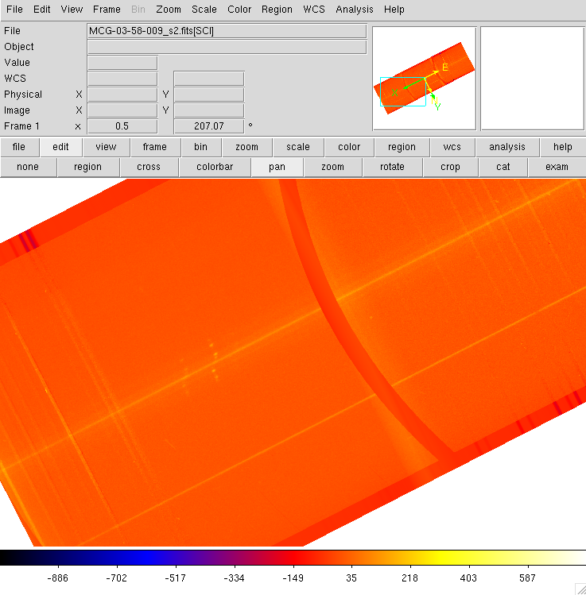
blue
red
Increasing wavelength
Notes:
Correct (11/20/17)

Slide 9
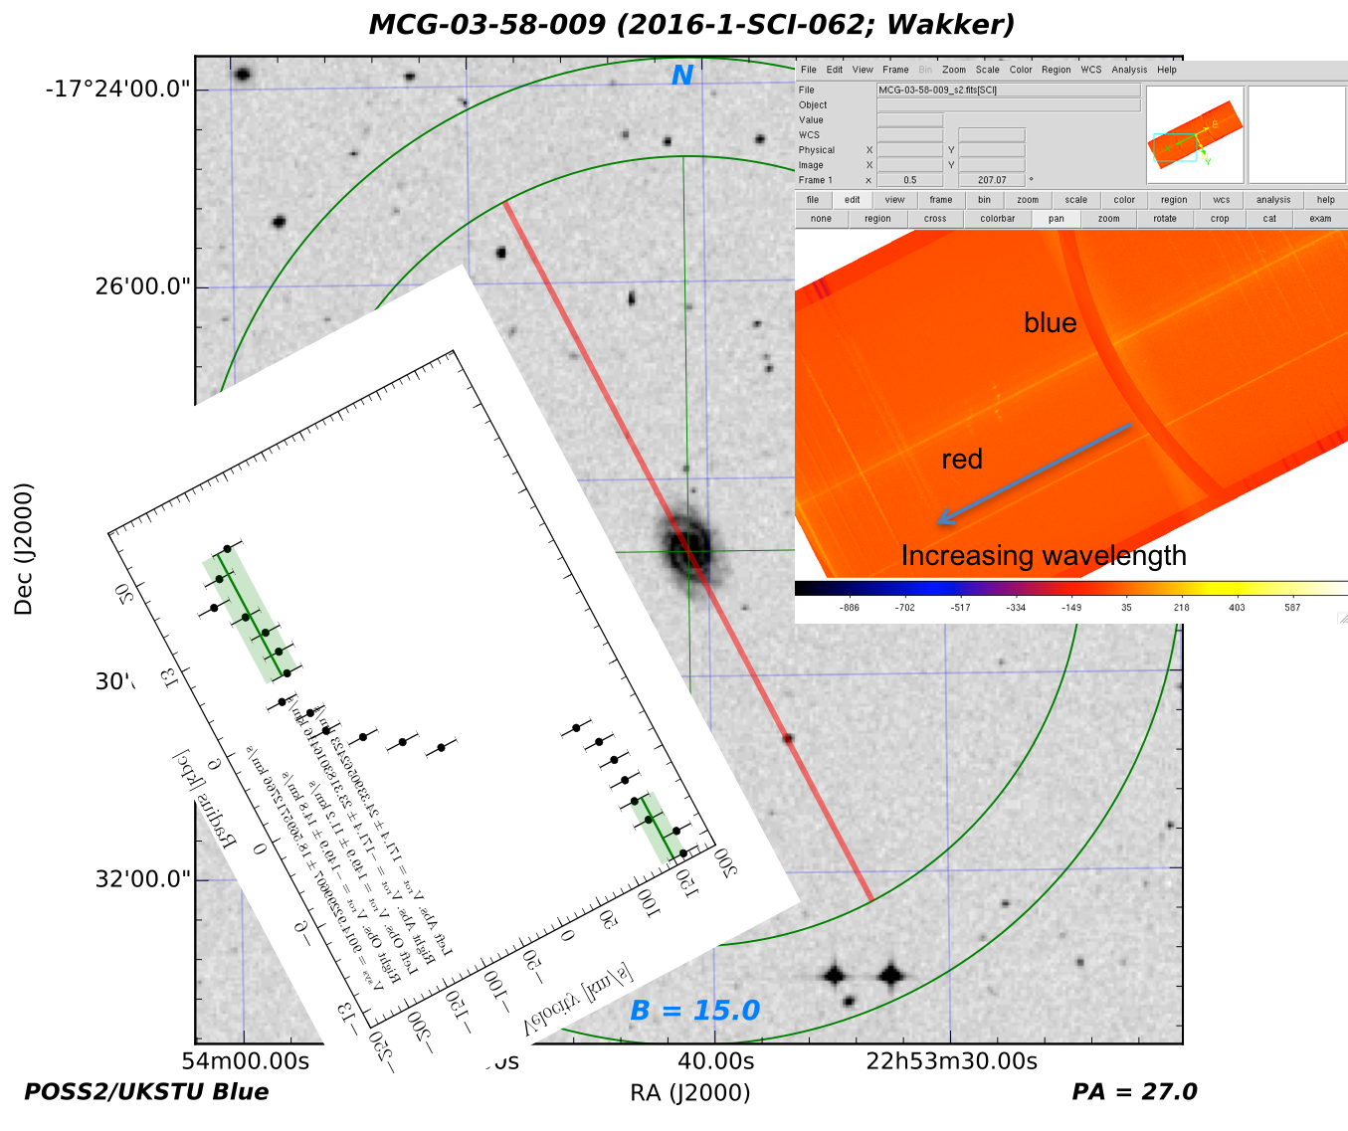
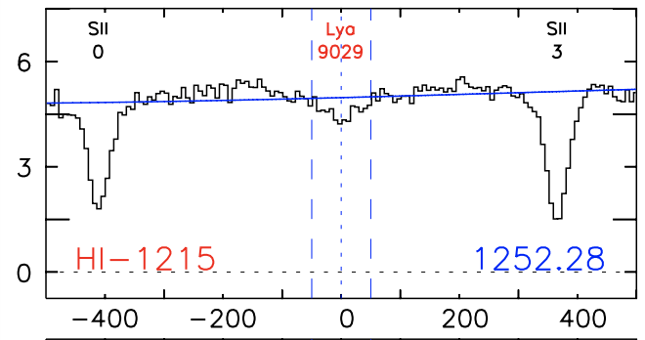
-150 km/s
+150 km/s
dv = -1 km/s
Notes:
Correct (12/06/17)

Slide 10
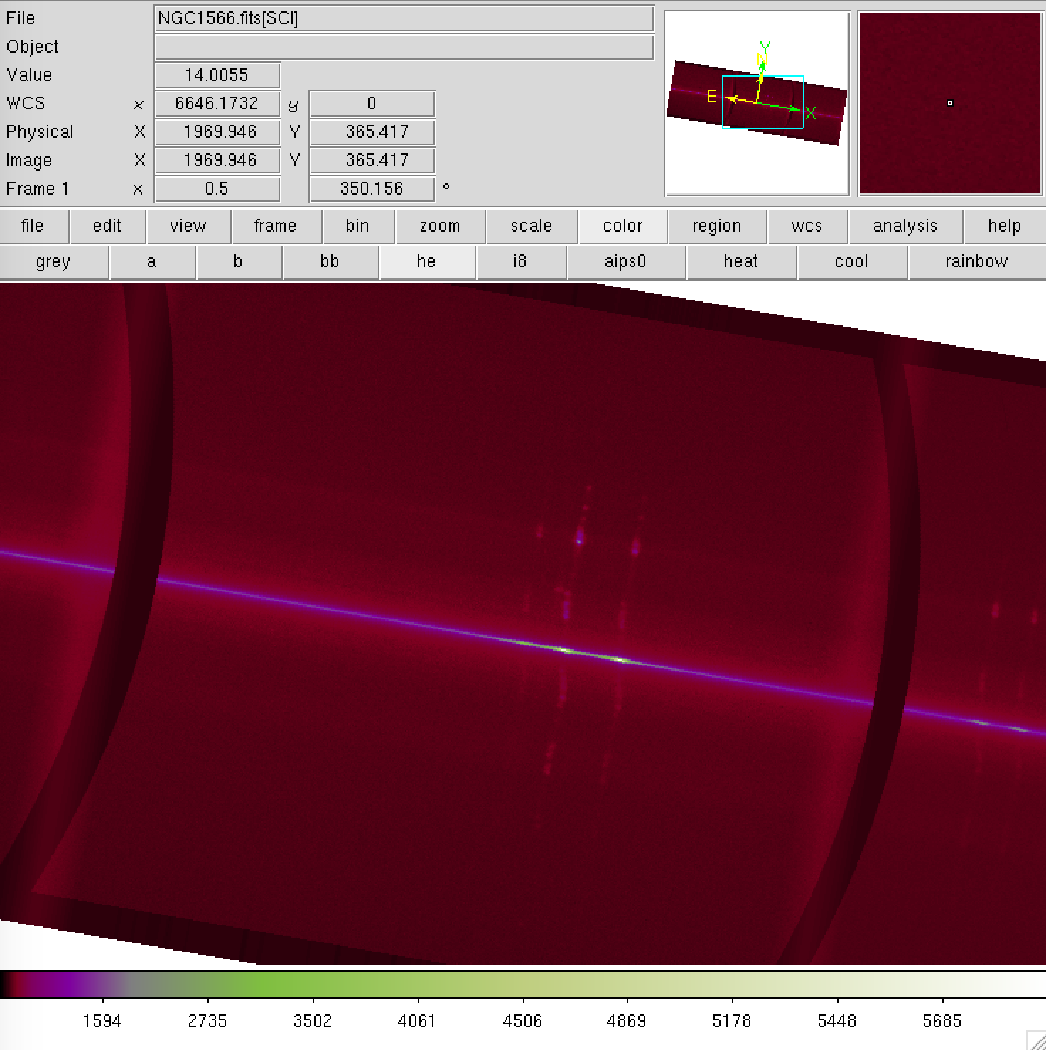
Increasing wavelength
Blue side
Red side
Notes:
Correct (11/20/17)

Slide 11
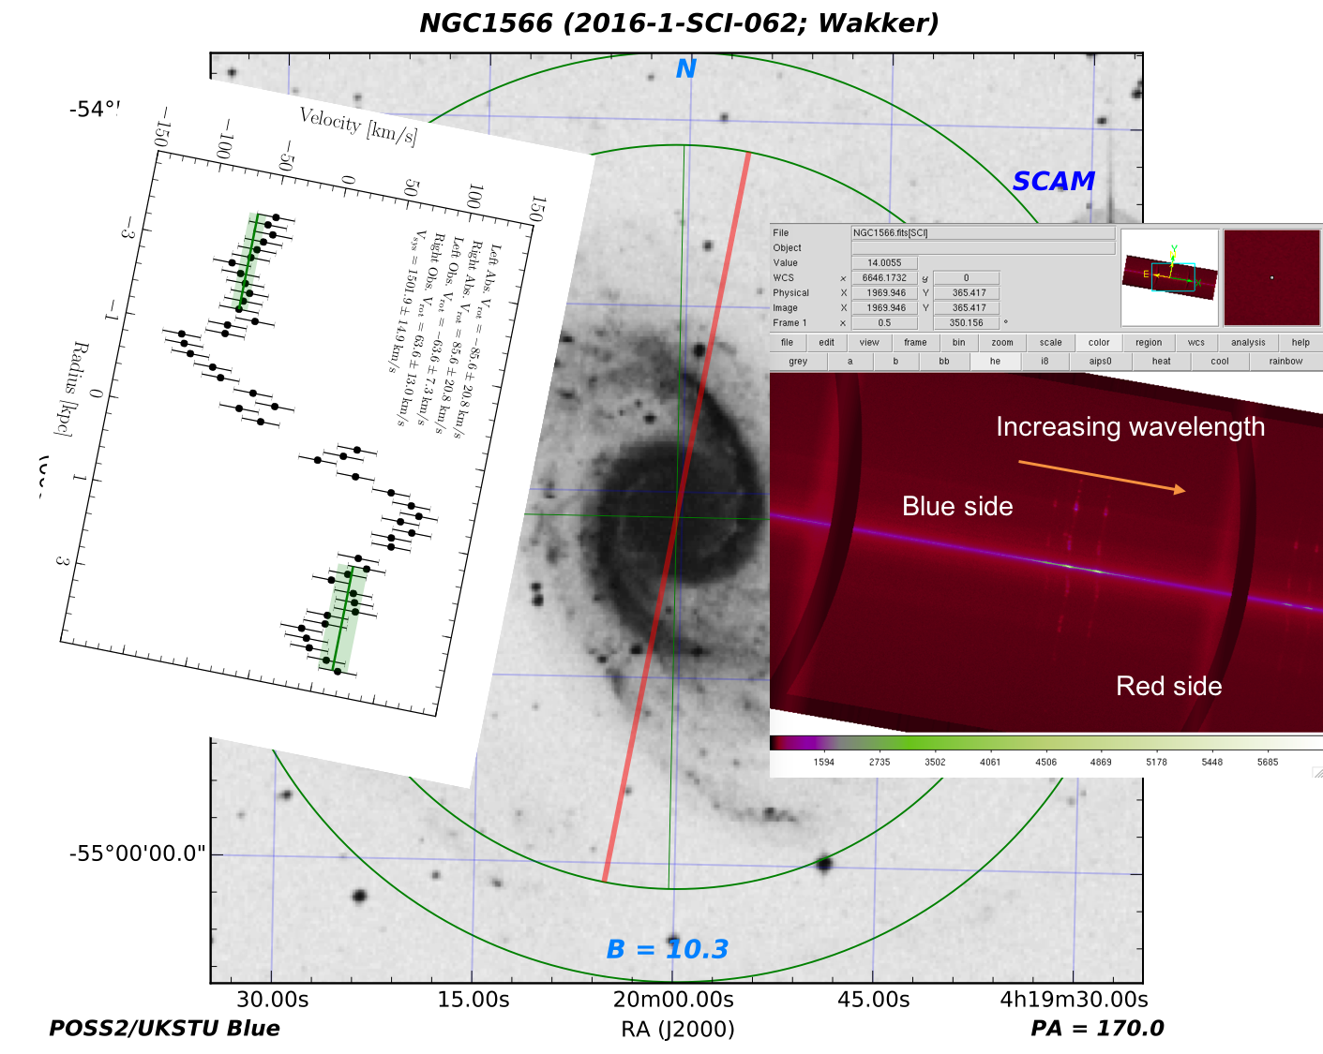
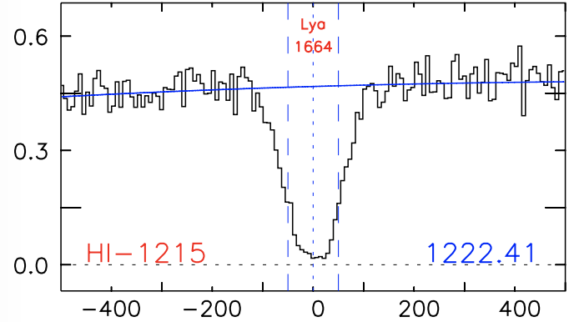
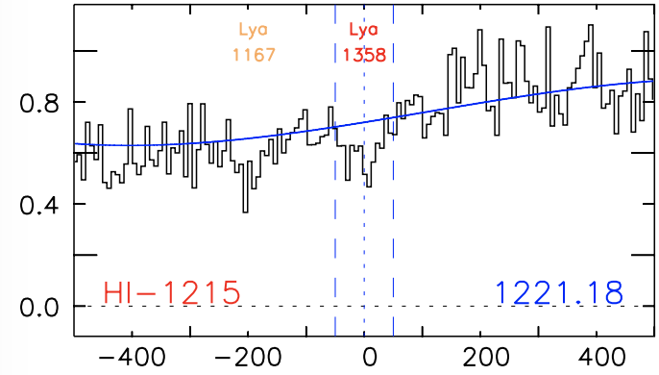
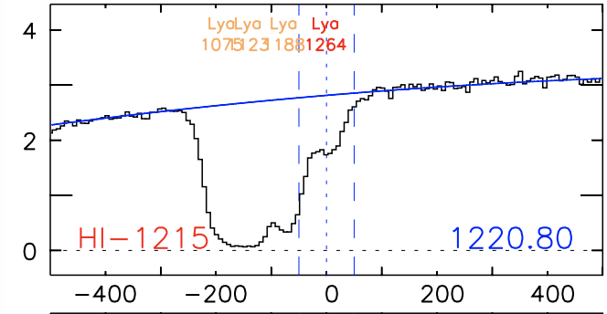
dv=159
dv=-337
dv=-146
-64km/s
+64km/s
dv=-431
dv=-380
dv=-317
dv=-239
Notes:
Correct (12/07/17)

Slide 12
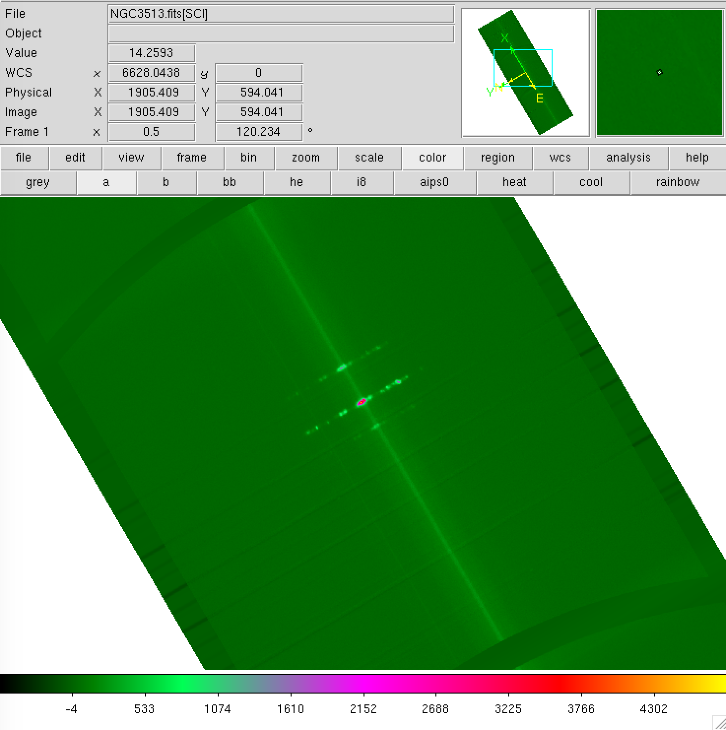
Increasing wavelength
Blue side
Red side
Notes:
Correct (11/20/17)

Slide 13
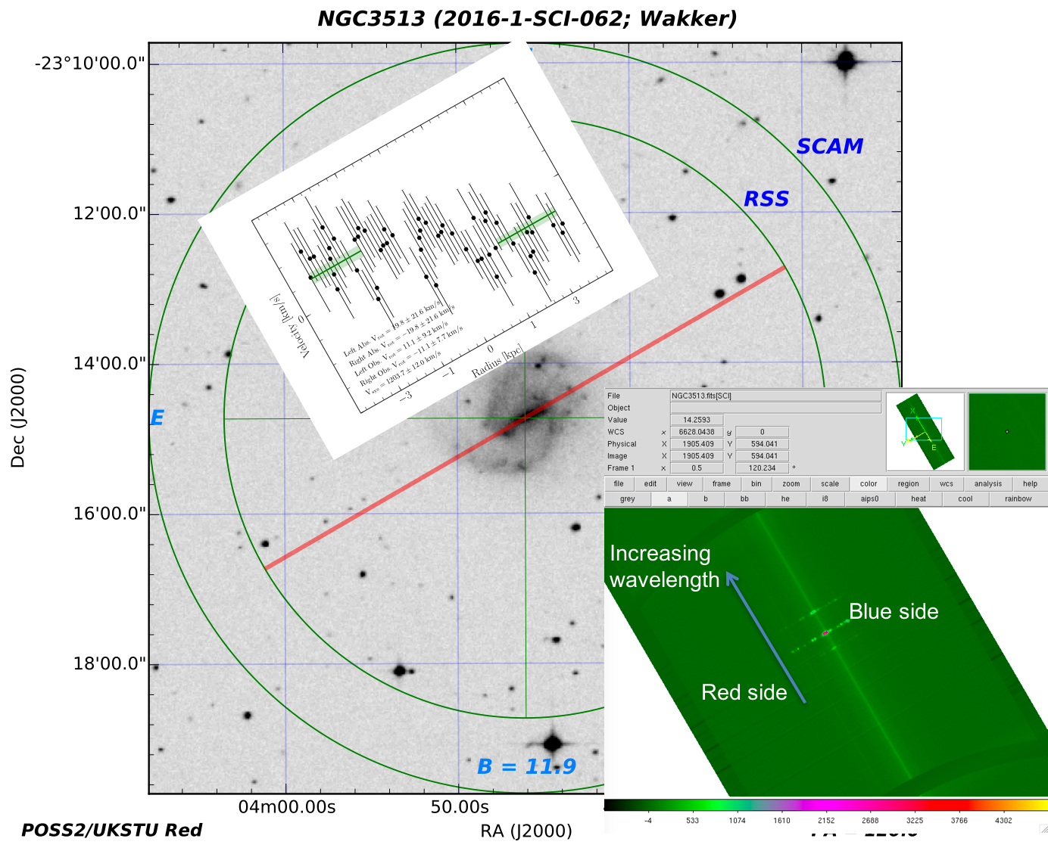
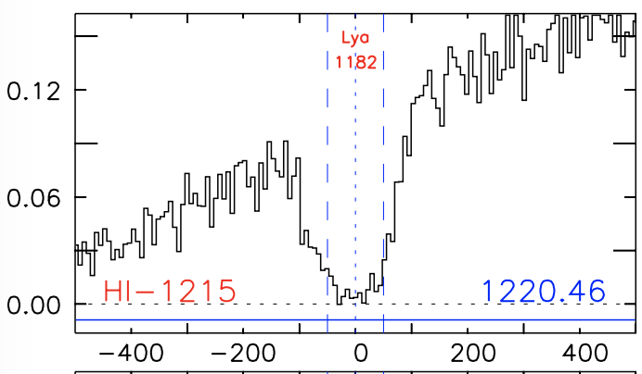
-11 km/s
+11 km/s
dv = -12 km/s
Notes:
Correct (12/06/17)

Slide 14
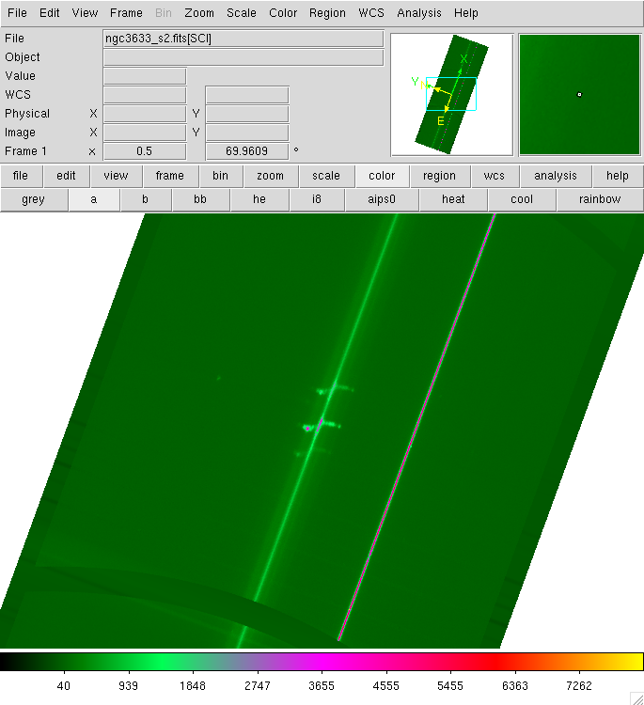
Increasing wavelength
Red side
Blue side
Notes:
This should be correct (11/20/17)

Slide 15
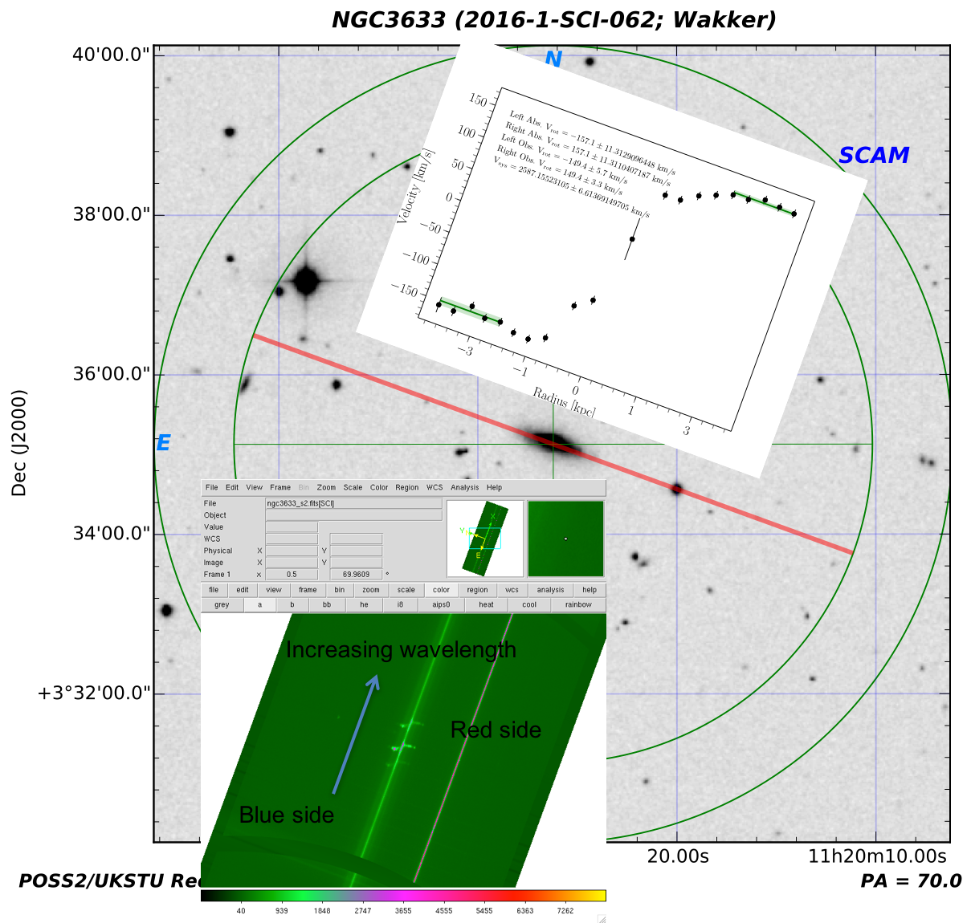
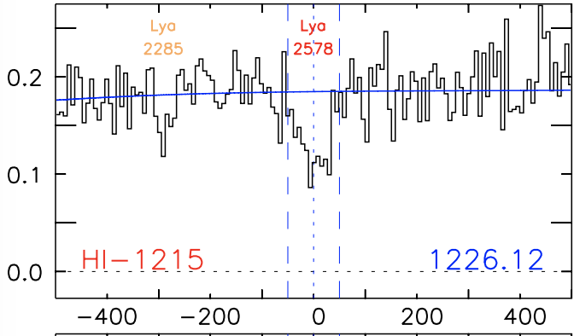
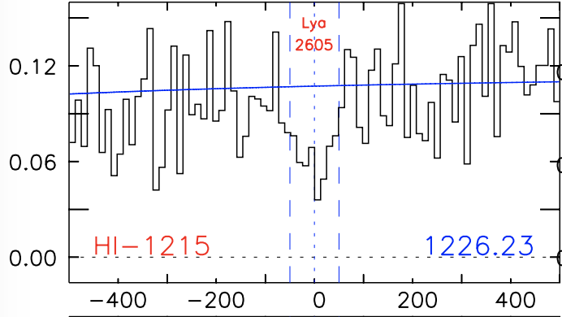
dv = -22 km/s
dv = -315 kms/
-149 km/s
+149 km/s
dv = +5 km/s
Nothing
Notes:
This should be correct (12/06/17)

Slide 16
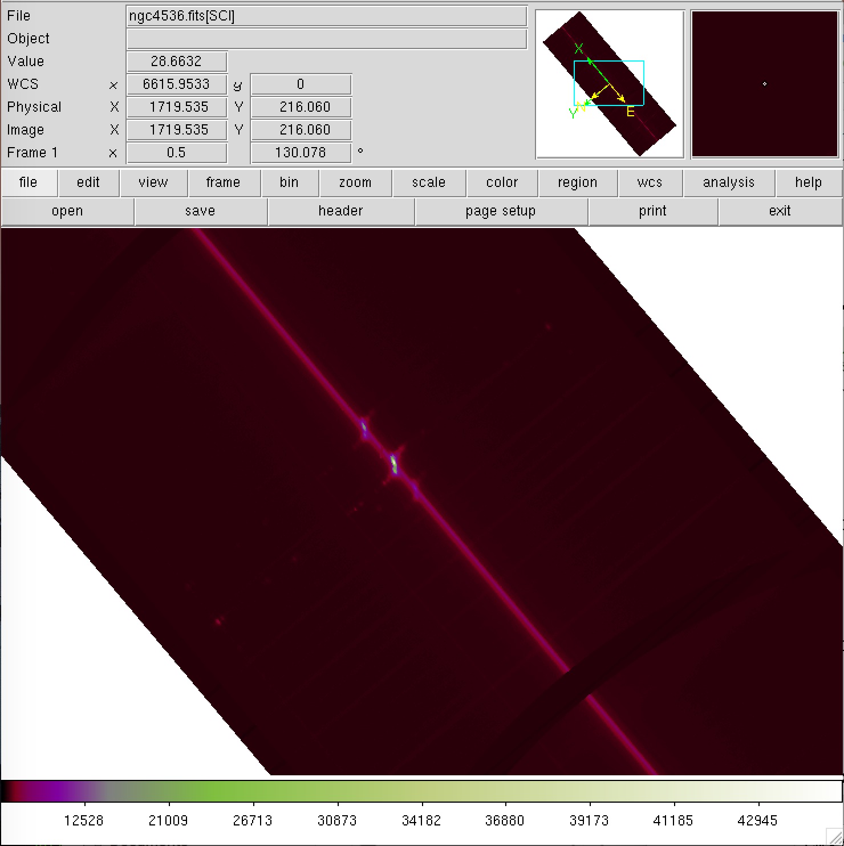
Increasing wavelength
Red side
Blue side
Notes:
Correct (11/20/17)

Slide 17
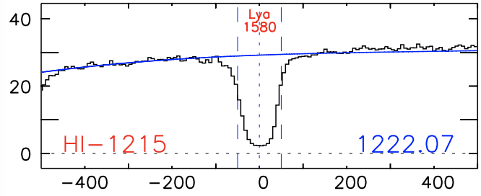
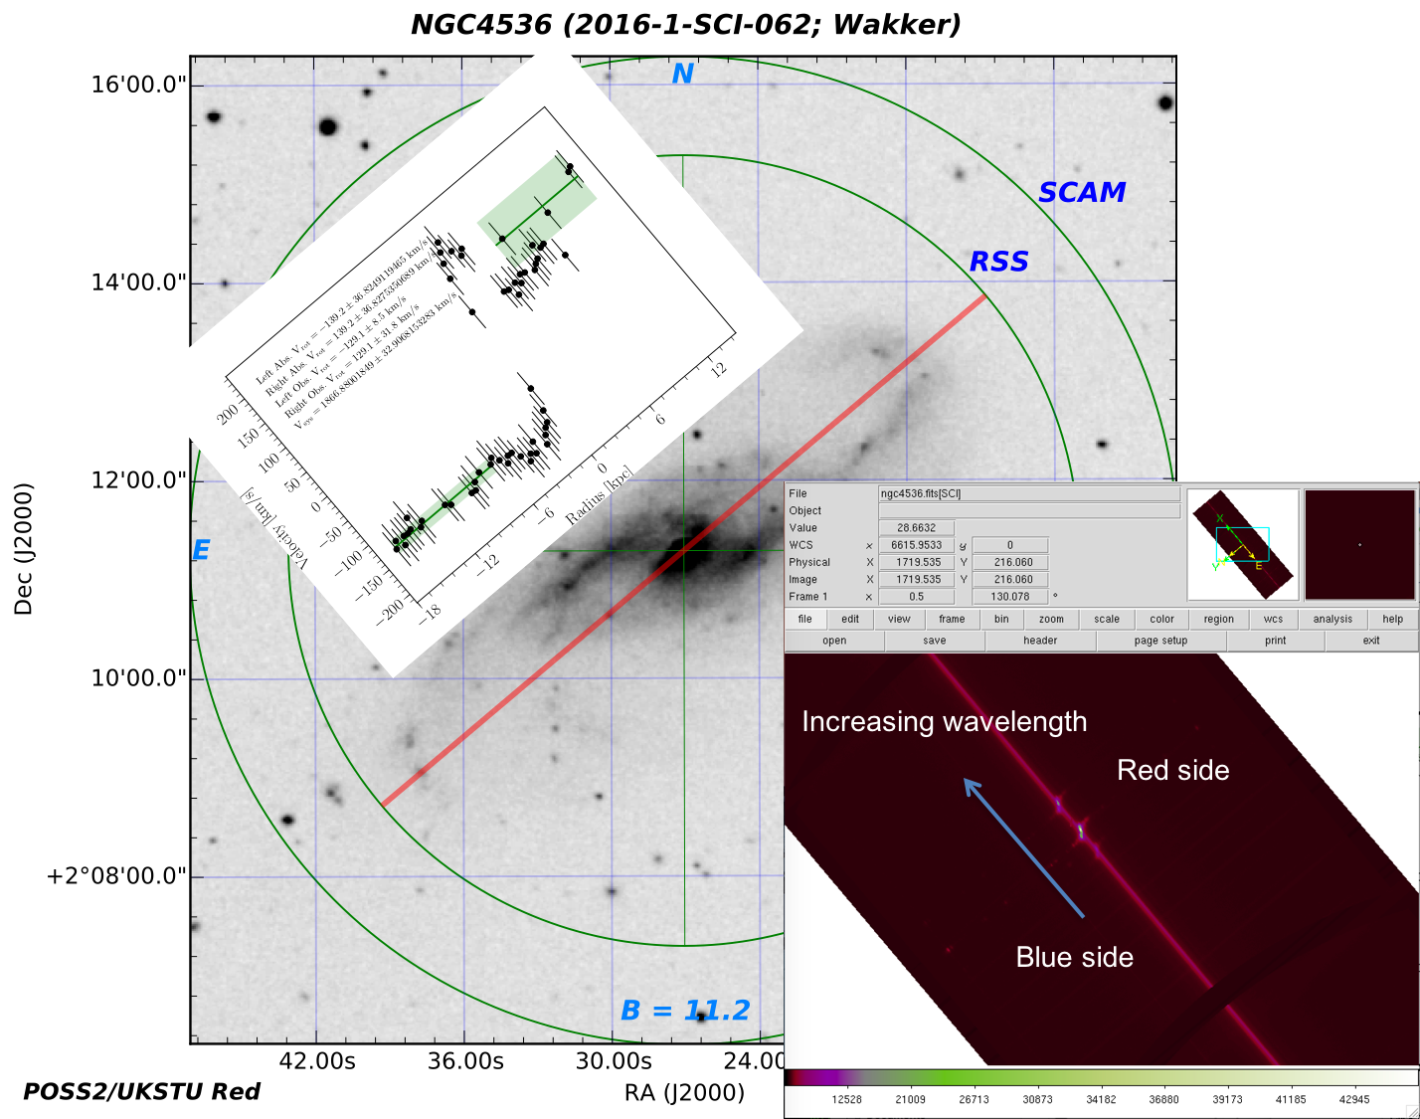
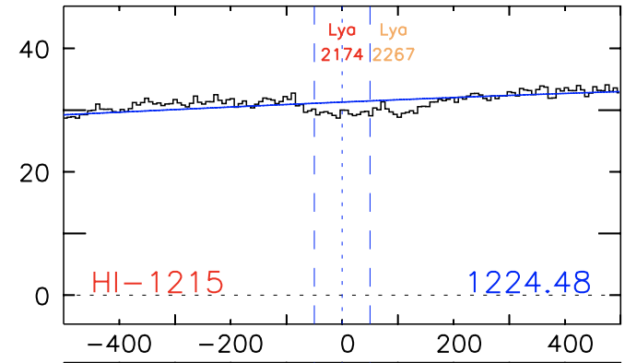
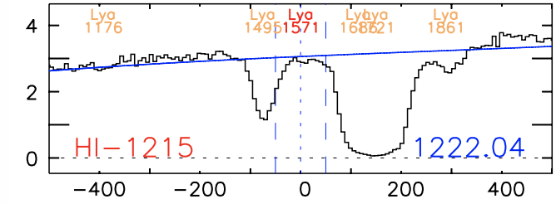
dv=-228
dv=366
+129km/s
-129km/s
dv=-313
dv=-238
dv=-124
dv=-88
dv=53
Notes:
Correct (12/07/17)

Slide 18
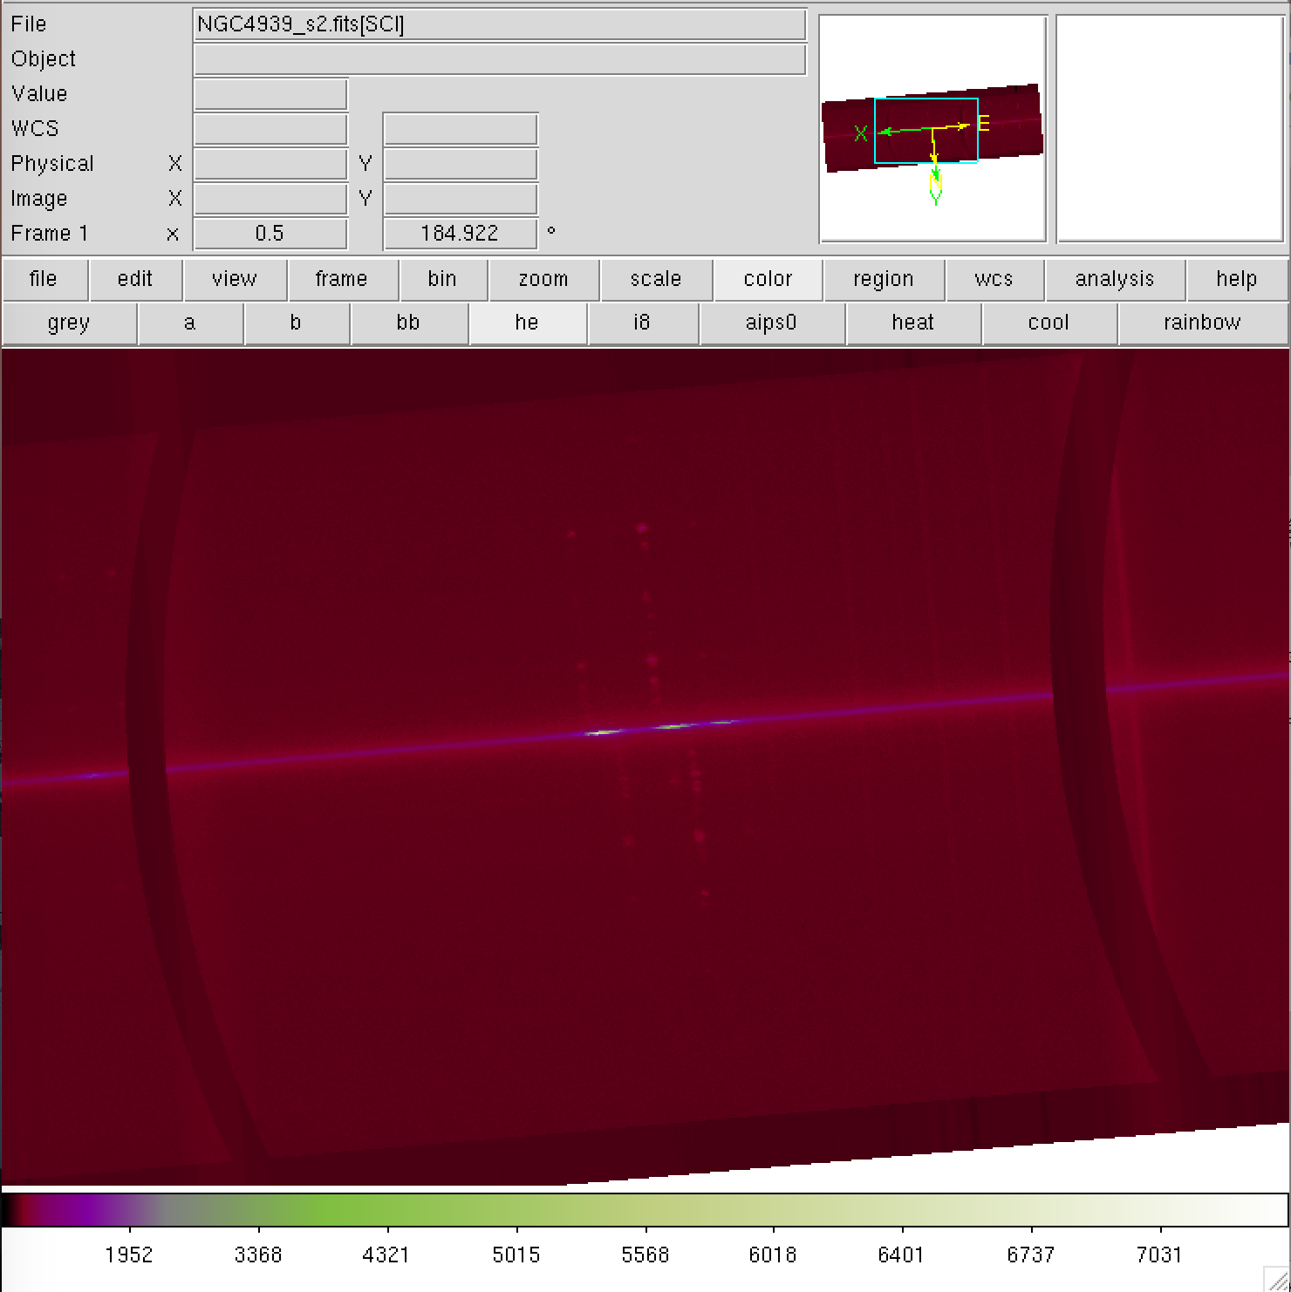
red
blue
Increasing wavelength
Notes:
Probably correct (11/20/17)

Slide 19
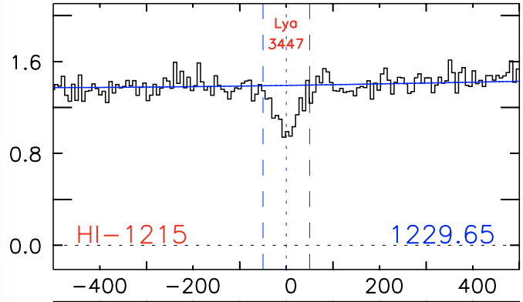
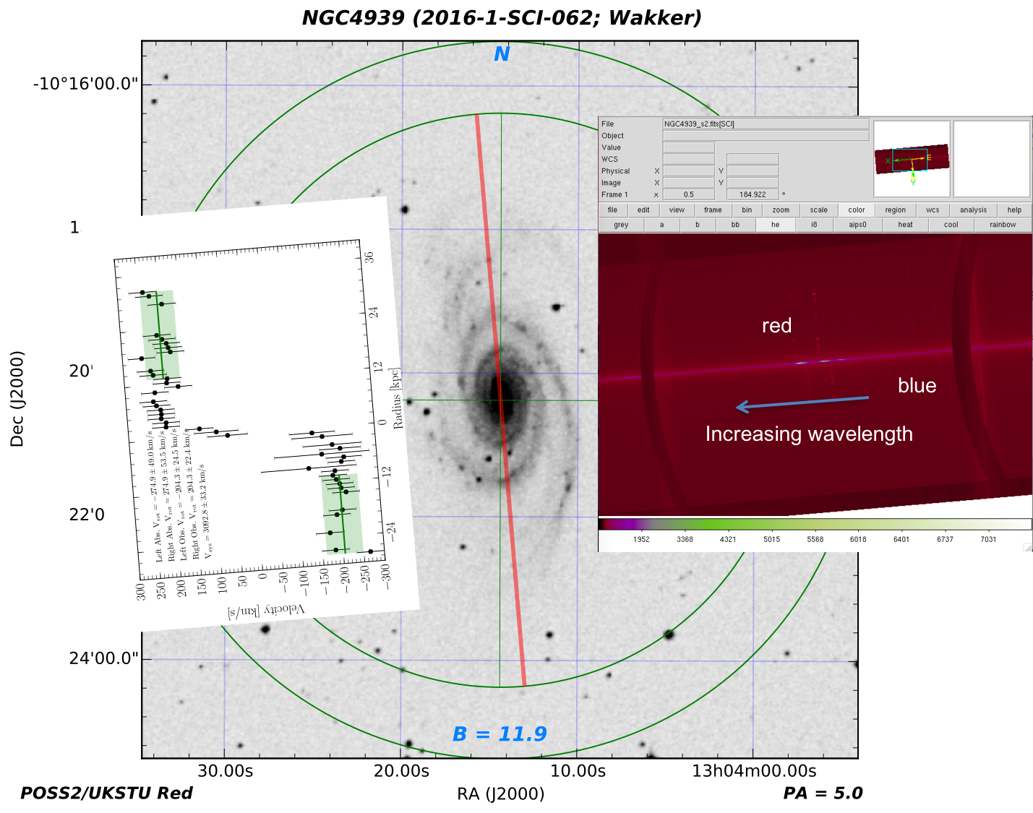
+204 km/s
dv=337km/s
-204 km/s
Notes:
Probably correct (12/07/17)

Slide 20
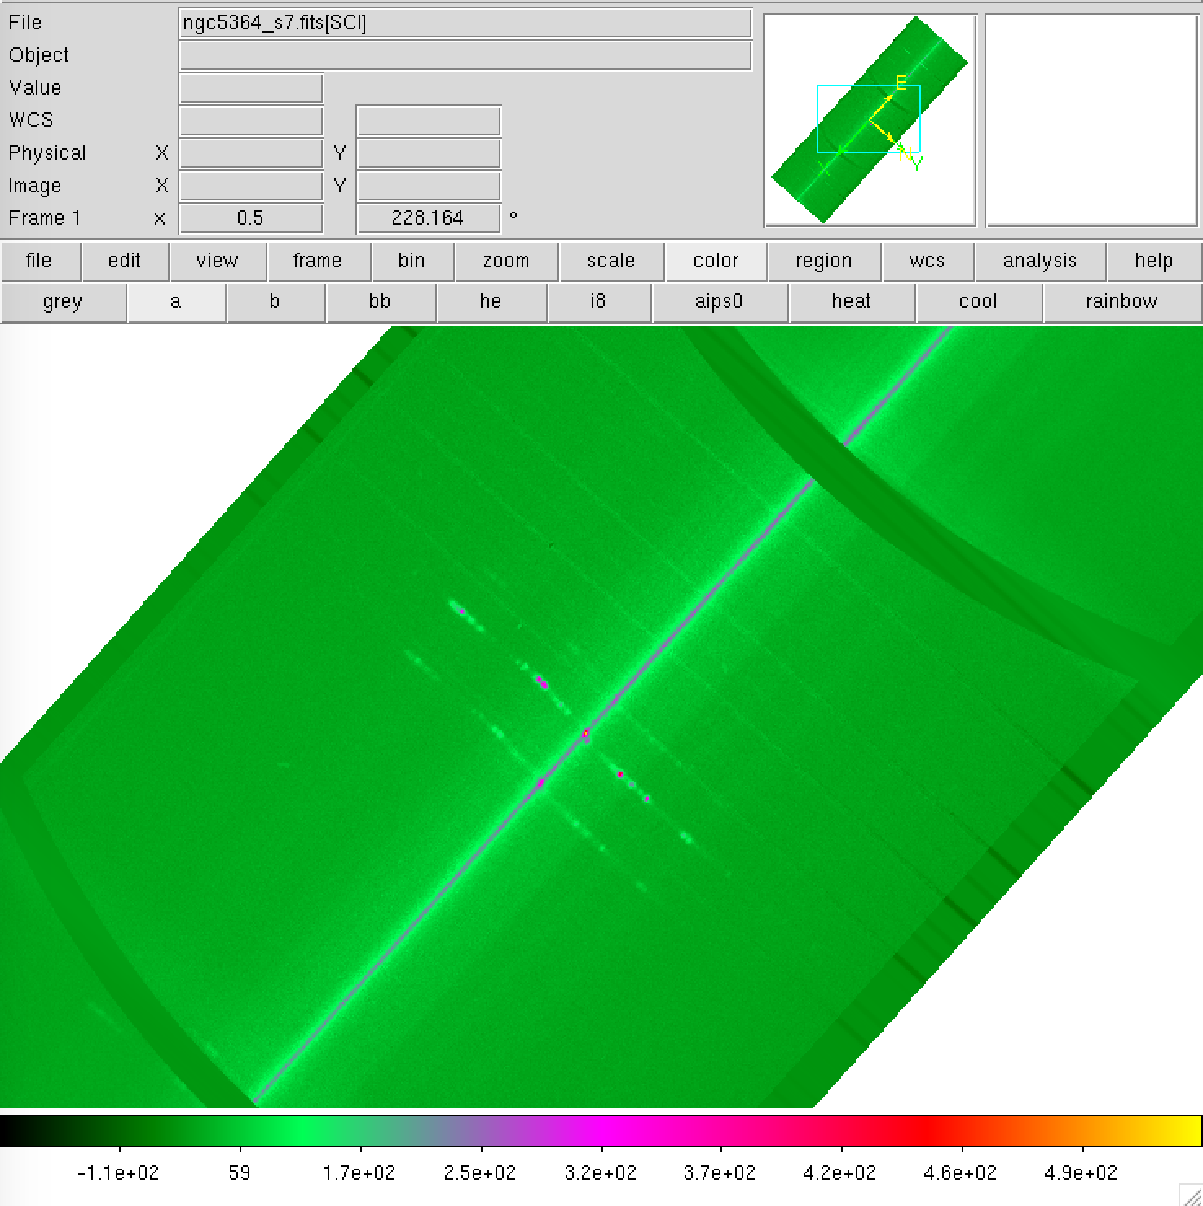
Blue side
Red side
Increasing wavelength

Slide 21
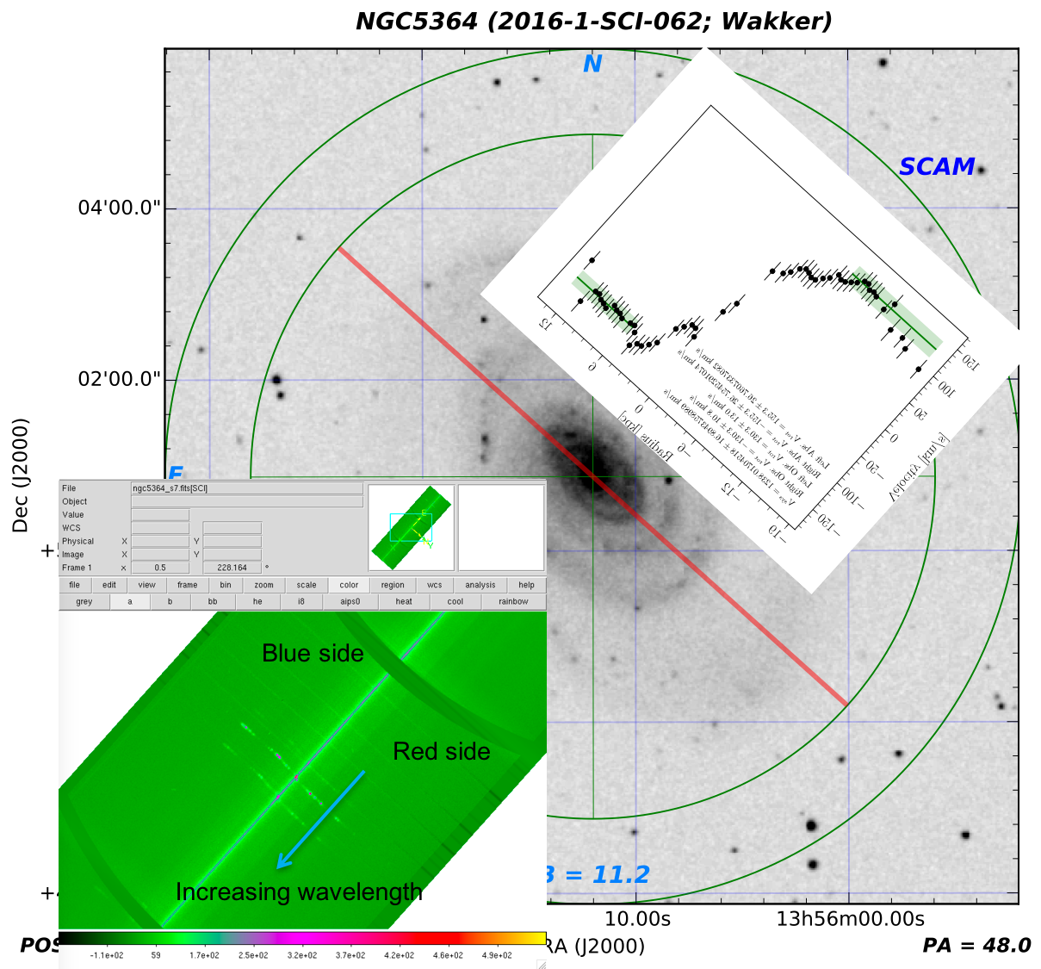
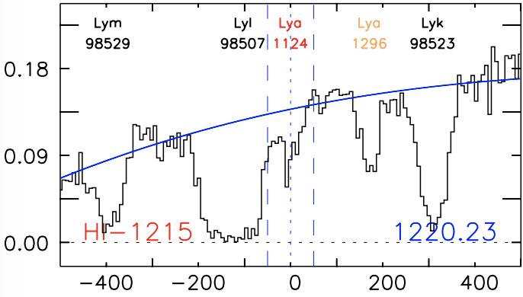
-130km/s
130km/s
dv=-117
dv=55
Notes:
Corrected (12/07/2017)

Slide 22
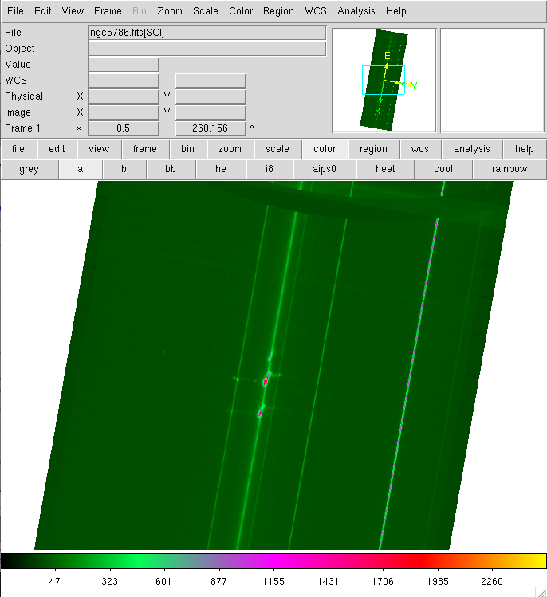
Red side
Blue side
Increasing wavelength
Notes:
This should be correct (11/20/17)

Slide 23
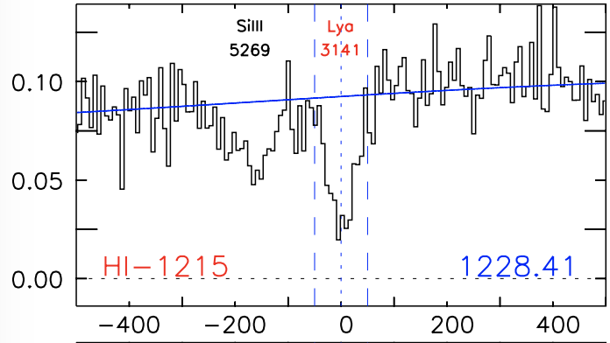
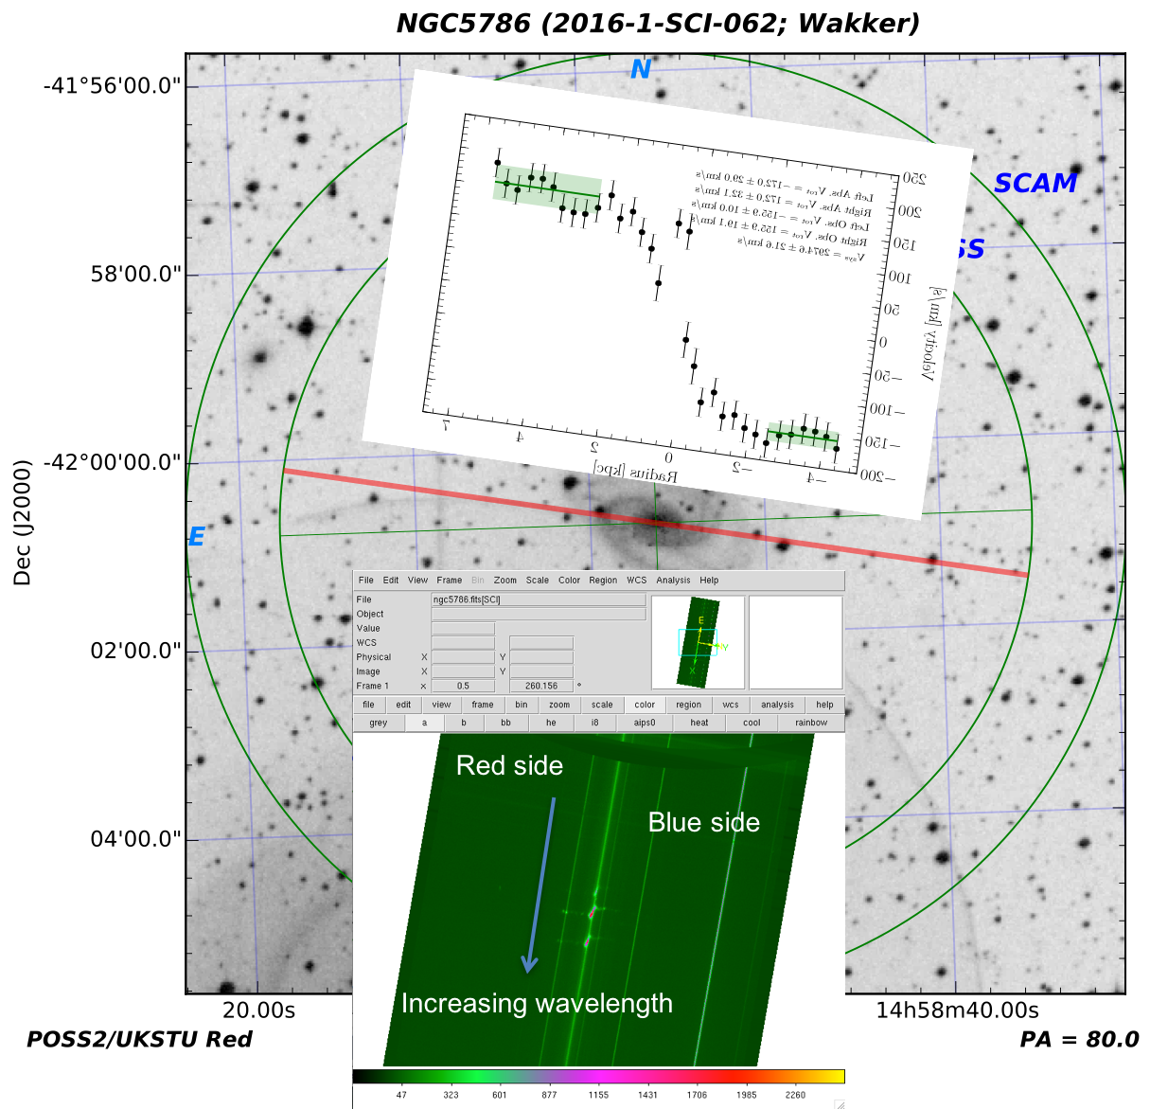
dv=143km/s
+156km/s
-156km/s
Notes:
This should be correct (12/07/17)

Slide 24
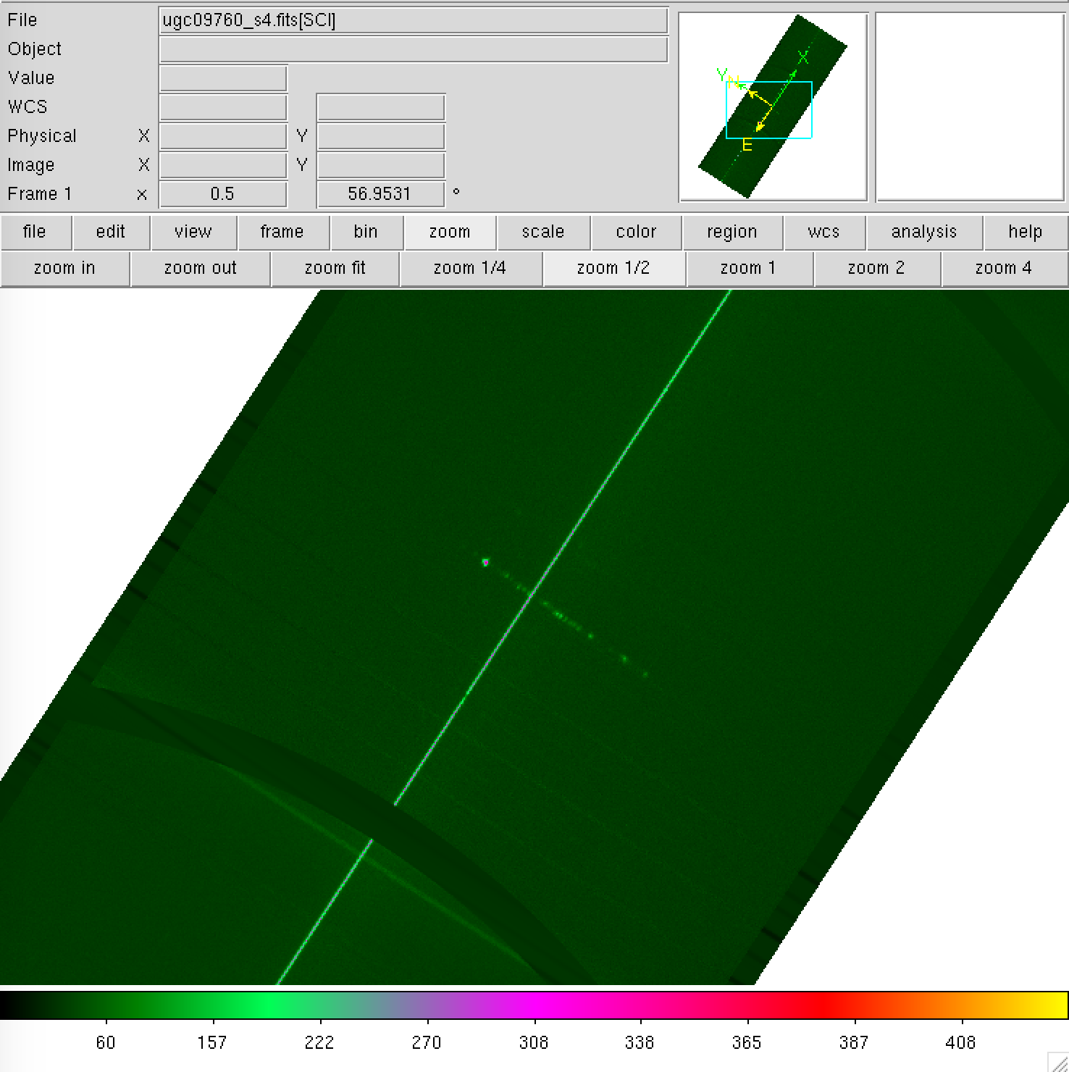
Increasing wavelength
Red side
Blue side
Notes:
Correct (11/20/17)

Slide 25
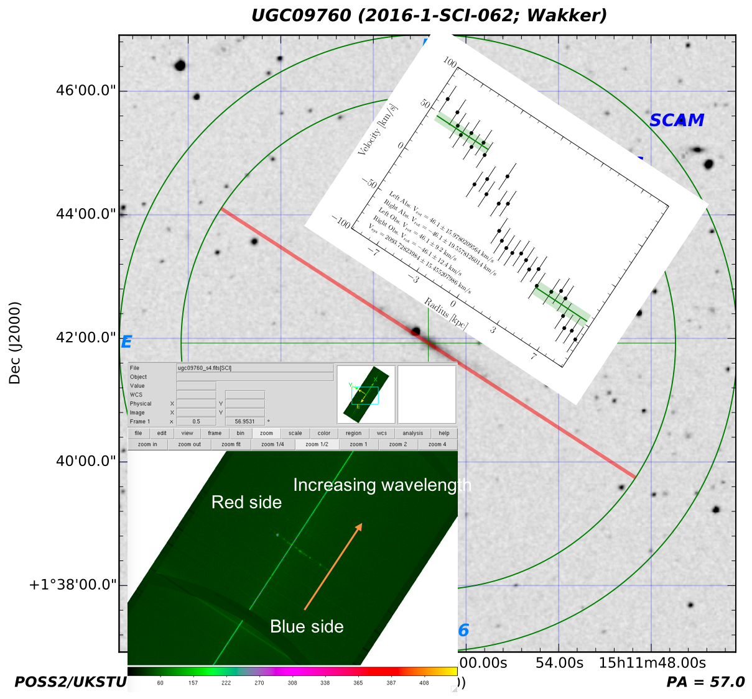
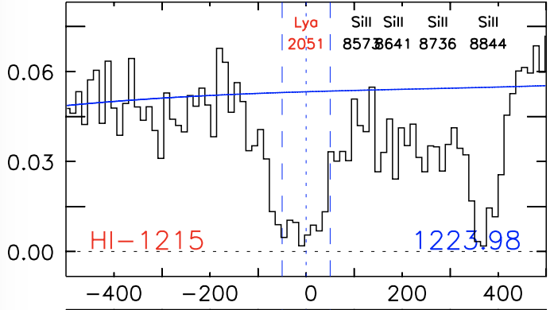
+46km/s
-46km/s
dv=29km/s
Notes:
Correct (12/07/17)

